Slide 1
2016/17 Knowledge Sharing Program with Bulgaria Promotion of Bulgarian Small and Medium Enterprises
Hang Yong LEE
Hangyang University
Aug. 29, 2016
Ministry of Strategy and Finance of Korea
Korea Development Institute (KDI)
Bulgarian Small and Medium Enterprises Promotion Agency

Slide 2
Background
SMEs are important for sustainable economic growth
Flexible in size, organization and management
Easier to bring new ideas and to take risky attempts
But, there are market failure: financing, human resources,
technology, marketing, etc.
Need government support
Notes:
2

Slide 3
SMEs vs. Large corporations in Korea
Contribution by SMEs to value added (mfg)
Share of SME employment
But, productivity and profitability of SMEs are lower relative to LEs in Korea
Notes:
3

Slide 4
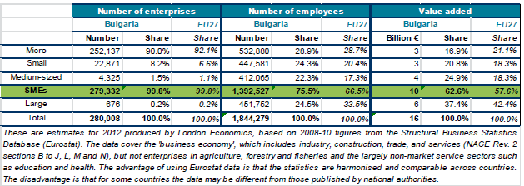
SMEs in Bulgaria
The contribution of SMEs in Bulgaria in creating value added and jobs exceeds the EU average.
Notes:
4

Slide 5
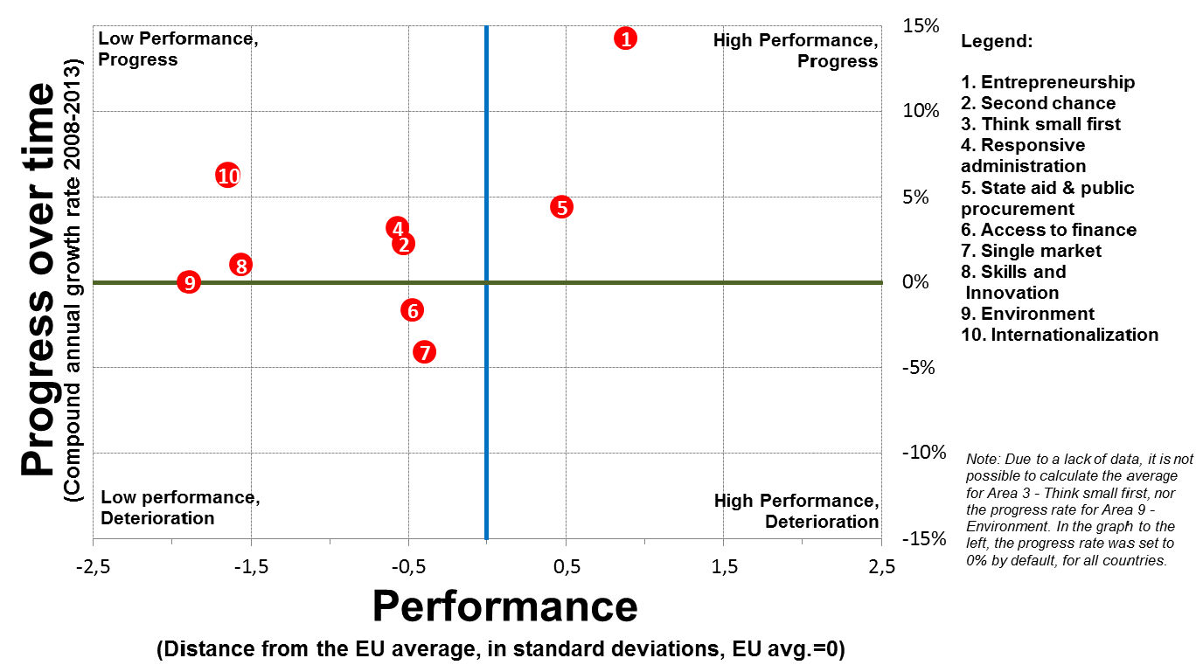
Bulgaria’s SBA performance
Source: 2013 SBA Fact Sheet, European Commission
Notes:
5

Slide 6
Public institutions for SMEs in Korea
The Small and Medium Business Administration (SMBA)
and the Small and Medium Business Corporation (SBC)
SBC provides financing for SMEs and operates advisory
programs including consulting, training, marketing and
global cooperation programs to enhance global
competitiveness.
Government funded financial institutions: KDB,
Korea Exim Bank, Korea Credit Guarantee Fund,
Korea Technology Finance Corporation,
Korea Venture Investment Corporation
Notes:
6

Slide 7
What to do
We introduce the government policies and programs to
support SMEs in Korea (focusing on financial policies and
programs)
We explain and exchange the lessons learned from
Korean experience
We try to identify necessary steps to foster SMEs in
Bulgaria.
Notes:
7

